Slide 1

Software Project Management

Slide 2
The Aim of Project Management
To complete a project:
• On time
• On budget
• With required functionality
• To the satisfaction of the client
• Without exhausting the team

Slide 3
The Project Manager
• Create and maintain the schedule
• Should track progress against schedule
• Keep some slack in the schedule
• Be continually making adjustments:
Start activities before previous activity complete
Sub-contract activities
Renegotiate deliverables
• Keep senior management informed

Slide 4
Software Project Management
Software project management
  Management discipline about planning, monitoring and controlling software projects
Project planning
  Identify the scope, estimate the work involved, and create a project schedule
Project monitoring and control
  Keep the team up to date on the project's progress and handle problems

Slide 5
Project Planning Activities
Estimation:
  Effort, cost, resource, and project duration
Project scheduling:
Staff organization:
  staffing plans
Risk handling:
  identification, analysis, and abatement procedures
Miscellaneous plans:
  quality assurance plan, configuration management plan, etc.

Slide 6
SPMP Document
After planning is complete:
  Document the plans: in a Software Project Management Plan(SPMP) document.

Slide 7
Organization of SPMP Document
  Introduction (Objectives,Major Functions,Performance Issues,Management and Technical Constraints)
  Project Estimates (Historical Data,Estimation Techniques,Effort, Cost, and Project Duration Estimates)
  Project Resources Plan (People,Hardware and Software,Special Resources)
  Schedules (Work Breakdown Structure,Task Network, Gantt Chart Representation,PERT Chart Representation)
  Stuff organization (Team Structure, Management Reporting)
  Risk Management Plan (Risk Analysis,Risk Identification,Risk Estimation, Abatement Procedures)
  Project Tracking and Control Plan
  Miscellaneous Plans(Process Tailoring,Quality Assurance)

Slide 8
Software Cost Estimation
Determine size of the product.
From the size estimate,
  determine the effort needed.
From the effort estimate,
  determine project duration, and cost.

Slide 9
Software Cost Estimation
Effort Estimation
Cost Estimation
Size Estimation
Staffing Estimation
Duration Estimation
Scheduling

Slide 10
Software Metrics
Measurement is fundamental to any engineering discipline, and software engineering is no exception.
To get an insight into the software process.
To do process improvement.
To make the quality of the product better.
To express the qualitative factor by a number.
To make a better estimate of the cost, schedule, complexity, effort requirements etc. of the s/w development process.

Slide 11
Software Metrics
Measures, Measurements, Metrics, Indicators
S/W
Engineering
Process
S/W Projects
Measures
Data Collection
Metrics
S/W
Products
Metrics
Computation
Metrics
Evaluation
Indicators

Slide 12
Software Metrics
Size Oriented Metrics
The size oriented metrics are those metrics, which are computed keeping size of the software as main consideration.
The size of the software are usually expressed in terms of KLOC ( Kilo Line Of Code ).
LOC (Lines of Code):
  Simplest and most widely used metric.
  Comments and blank lines should not be counted

Slide 13
Disadvantages of Using LOC
Size can vary with coding style.
Focuses on coding activity alone.
Correlates poorly with quality and efficiency of code.
Penalizes higher level programming languages, code reuse, etc.
Measures lexical/textual complexity only.
  does not address the issues of structural or logical complexity.
Difficult to estimate LOC from problem description.
  So not useful for project planning

Slide 14
Function Point Metric
Overcomes some of the shortcomings of the LOC metric
Proposed by Albrecht in early 80's:
  FP=4 *#inputs + 5 * #Outputs + 4 * #inquiries + 10 * #files + 10 * #interfaces
Input:
  A set of related inputs is counted as one input.

Slide 15
Function Point Metric
Output:
  A set of related outputs is counted as one output.
Inquiries:
  Each user query type is counted.
Files:
  Files are logically related data and thus can be data structures or physical files.
Interface:
  Data transfer to other systems.

Slide 16
Function Point Metric (CONT.)
Suffers from a major drawback:
  the size of a function is considered to be independent of its complexity.
Extend function point metric:
  Feature Point metric:
  considers an extra parameter:
    Algorithm Complexity.

Slide 17
Function Point Metric (CONT.)
Proponents claim:
  FP is language independent.
  Size can be easily derived from problem description
Opponents claim:
  it is subjective --- Different people can come up with different estimates for the same problem.

Slide 18
Project Estimation Techniques
  Empirical Estimation Techniques
  Heuristics Techniques
  Analytical Techniques

Slide 19
Empirical Estimation Techniques
Empirical: derived from experiment, experience and observation rather than theory
Using prior experience you make an educated guess
We are going to learn two empirical estimations techniques:
  Expert judgment
  Delphi estimation technique

Slide 20
Heuristic Estimation Techniques
Using this techniques assumes that there is a relationship among the different project parameters that can be expressed using a mathematical formula
The mathematical formula to estimate the resource is usually represented as
  where C₁ , C₂, D₁, D₂, … are constants (historical data)
  e is the characteristics of the software (historical data)
COCOMO model is a multivariate heuristic estimation technique (vs. single variant)
Estimated Resource = C₁۰e^{D}₁ + C₂۰e^{D}₂ + …

Slide 21
Analytical Estimation Techniques
These techniques have a scientific basis
Halstead’s software science is an example
  Especially useful for estimating maintenance efforts, since it outperforms the previous methods in calculating it
This method starts with basic assumptions about the project to derive the required results

Slide 22
Empirical Estimation Techniques

Slide 23
Expert Judgment Technique
An expert makes an educated guess after analyzing the problem thoroughly
Estimate individual modules and then sum the estimations
Affected by human errors and bias
The expert may not be an expert in every technical field
  Use group of experts
Group of experts decision may still be biased, and assertive member have higher influence on the final estimate

Slide 24
Delphi Cost Estimation
Tries to overcome the shortcoming of Expert judgment method
Group of experts and a coordinator
  Coordinator gives each expert a copy of the SRS document and a form to fill the estimation
  The experts estimates and gives his reasoning
  Coordinator collects the forms and the summary of reasons and redistribute them to experts to re-estimate
  Several iterations/rounds may happen
  The coordinator is responsible of compiling the final results and provide the final estimate

Slide 25
Heuristic Estimation Techniques

Slide 26
COCOMO Heuristic Estimation
COCOMO: Constructive Cost Estimation Model
Software development project can categorized on their complexity
  Organic
  Semidetached
  Embedded
Consider the characteristics of the product, of the development team and the development environment

Slide 27
COCOMO Heuristic Estimation
There are three main types of projects
  Application
    Data processing programs, (payroll system : simple algorithm computed for many entries)
  Utility
    Compilers, linkers, IDE (Integrated Development Environment) … etc
  System programs
    Hardware, strict time constraints … etc
The complexity ratio is 1:3:9

Slide 28
COCOMO Heuristic Estimation
Organic
  Problem is well known and understood
  Small team size
  Experienced team members in the problem
Semidetached
  Mix of experienced and inexperienced
  May have limited experience or unfamiliar with some of the aspect of the system
Embedded
  Strongly coupled to complex hardware
  Or stringent regulation on the system operations

Slide 29
COCOMO Heuristic Estimation
Estimate the effort in (PM: person-month) unit, and the development time from size estimation given in KLOC
  One instructions with n line : nLOCs
One person-month is the effort a person can put in a month
  Takes into account holidays, breaks … etc
Software cost estimation are done through three stages: basic COCOMO, intermediate COCOMO, and complete COCOMO

Slide 30
Basic COCOMO
Basic COCOMO is given using the following two expressions:
  a₁, b₁, a₂, b₂ are constants
Effort = a₁ × (KLOC)ª₂ in PM
T_{dev} = b₁ × (Effort)^{b}₂ in months

Slide 31
Person- Month Calculation
Number of
persons in the development team
Time

Slide 32
Basic COCOMO
Nominal Effort
Organic :- Effort = 2.4 × (KLOC)^{1.05} in PM
Semidetached :- Effort = 3.0 × (KLOC)^{1.12} in PM
Embedded:- Effort = 3.6 × (KLOC)^{1.20} in PM
Nominal Development Time
Organic:- T_{dev} = 2.5 × (Effort)^{0.38} in months
Semidetached:- T_{dev} = 2.5 × (Effort)^{0.35} in months
Embedded:- T_{dev} = 2.5 × (Effort)^{0.32} in months

Slide 33
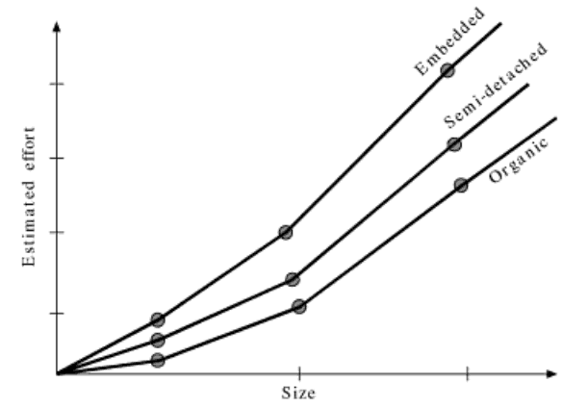
Effort vs. Product Size

Slide 34
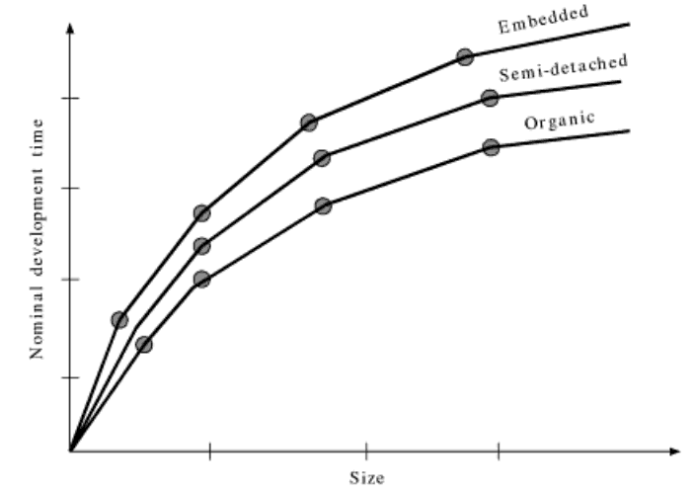
Development Time vs. Size

Slide 35
Basic COCOMO
Effort increases rapidly with the project size
When the size increases by two times, the time to develop the project increases only moderately
  Large product have more concurrent activities
  There is more scope to parallel activities in semidetached and embedded system
Total cost= Effort (in PM) × PM cost + project expenses (HW+ SW+ rent + … )

Slide 36
Example
size = 60 KLOC
Organic :- Effort = 2.4 × (KLOC)^{1.05} in PM
= 176.71 PM
Semidetached :- Effort = 3.0 × (KLOC)^{1.12} in PM
= 294.21 PM
Embedded:- Effort = 3.6 × (KLOC)^{1.20} in PM
= 489.87 PM
Organic:- T_{dev} = 2.5 × (Effort)^{0.38} in months
= 17.86 months
Semidetached:- T_{dev} = 2.5 × (Effort)^{0.35} in months
= 18.28 months
Embedded:- T_{dev} = 2.5 × (Effort)^{0.32} in months
= 18.15 months

Slide 37
Example
size = 500 KLOC
Organic :- Effort = 2.4 × (KLOC)^{1.05} in PM
= 1637.31 PM
Semidetached :- Effort = 3.0 × (KLOC)^{1.12} in PM
= 3162.04 PM
Embedded:- Effort = 3.6 × (KLOC)^{1.20} in PM
= 6238.3 PM
Organic:- T_{dev} = 2.5 × (Effort)^{0.38} in months
= 41.62 months
Semidetached:- T_{dev} = 2.5 × (Effort)^{0.35} in months
= 41.97 months
Embedded:- T_{dev} = 2.5 × (Effort)^{0.32} in months
= 40.96 months

Slide 38
Intermediate COCOMO model
Basic COCOMO depends only on the product size to estimate the required effort and development time
Intermediate COCOMO uses 15 cost multipliers based on various attributes of software development
If modern programming techniques are used then you scale down the initial estimate using the basic COCOMO
If there are stringent requirements on reliability are present, then you scale up the initial estimate

Slide 39
Intermediate COCOMO model (cont.)
Rate these 15 cost multipliers from 1 to 3
Depending on the rating Boehm suggests values for these multipliers
Cost drivers or multipliers are attributes of the following items:
  Product
  Computer
  Personnel
  Development Environment

Slide 40
Intermediate COCOMO model (cont.)
Product
  Complexity and reliability of the product … etc
Computer
  Execution speed and storage space required .. etc
Personnel
  Experience, programming capability, analysis capability … etc
Development Environment
  Development facilities, CASE tools … etc

Slide 41
Complete COCOMO model
Both basic and intermediate COCOMO consider the software product as a single homogenous entity
  Most large products/systems are made of smaller subsystems
  These subsystems may have widely different characteristics (organic, semidetached, embedded)
The total estimate is the sum estimates of the subsystems

Slide 42
Complete COCOMO model (cont.)
This approach reduces the margin of error in the final estimate
Example: Distributed Management Information System (MIS)
  Database subsystem
    Semidetached
  Graphical User Interface subsystem
    Organic
  Communication subsystem
    Embedded

Slide 43
Analytical Estimation Techniques

Slide 44
Halstead's Software Science
An analytical technique to estimate:
  size,
  development effort,
  development time.

Slide 45
Halstead's Software Science
Halstead used a few primitive program parameters
  number of operators and operands
Derived expressions for:
  over all program length,
  potential minimum volume
  actual volume,
  language level,
  effort, and
  development time.

Slide 46
Halstead’s Software Science
The measurable and countable properties are :
n1 = no of unique or distinct operators
n2 = no of unique or distinct operands
N1 = total usage of all of the operators
N2 = total usage of all of the operands
From these metrics Halstead defines :
the vocabulary n as n = n1 + n2
the implementation length N as N = N1 + N2

Slide 47
Example
if (k < 2)
{
if (k > 3)
x = x*k;
}
Distinct operators: if ( ) { } > < = * ;
Distinct operands: k 2 3 x
n₁ = 10
n₂ = 4
N₁ = 13
N₂ = 7

Slide 48

Halstead’s Metrics
Estimated length: = n₁ log₂ n₁ + n₂ log₂ n₂
  Close estimate of length for well structured programs
Volume: V = N log₂ n
  Number of bits to provide a unique designator for each of the n items in the program vocabulary.
Difficulty
Program effort: E=D*V
  This is a good measure of program understandability

Slide 49
Advantages of Halstead
Do not require in-depth analysis of programming structure.
Predicts rate of error.
Predicts maintenance effort.
Useful in scheduling and reporting projects.
Measure overall quality of programs.
Simple to calculate.
Can be used for any programming language.
Numerous industry studies support the use of Halstead in predicting programming effort and mean number of programming bugs.

Slide 50
Staffing Level Estimation
Number of personnel required during any development project:
  not constant.
Norden in 1958 analyzed many R&D projects, and observed:
  Rayleigh curve represents the number of full-time personnel required at any time.

Slide 51
Rayleigh Curve
Rayleigh curve is specified by two parameters:
  t_{d} the time at which the curve reaches its maximum
  K the total area under the curve.
L=f(K, t_{d})
Rayleigh Curve
Effort
t_{d}
Time

Slide 52
Rayleigh Curve
Very small number of engineers are needed at the beginning of a project
  carry out planning and specification.
As the project progresses:
  more detailed work is required,
  number of engineers slowly increases and reaches a peak.

Slide 53
Rayleigh Curve
Putnam observed that:
  the time at which the Rayleigh curve reaches its maximum value
    corresponds to system testing and product release.
  After system testing,
    the number of project staff falls till product installation and delivery.

Slide 54
Rayleigh Curve
From the Rayleigh curve observe that:
  approximately 40% of the area under the Rayleigh curve is to the left of t_{d}
  and 60% to the right.

Slide 55
Putnam’s Work:
In 1976, Putnam studied the problem of staffing of software projects:
  observed that the level of effort required in software development efforts has a similar envelope.
  found that the Rayleigh-Norden curve
    relates the number of delivered lines of code to effort and development time.

Slide 56
Putnam’s Work (CONT.):
Putnam analyzed a large number of army projects, and derived the expression:
L=C_{k}K^{1/3}t_{d}^{4/3}
  K is the effort expended and L is the size in KLOC.
  t_{d} is the time to develop the software.
  C_{k} is the state of technology constant
    reflects factors that affect programmer productivity.

Slide 57
Putnam’s Work (CONT.):
C_{k}=2 for poor development environment
  no methodology, poor documentation, and review, etc.
C_{k}=8 for good software development environment
  software engineering principles used
C_{k}=11 for an excellent environment

Slide 58
Effect of Schedule Change on Cost
Using the Putnam's expression for L,
K=L³/(C_{k}³t_{d}⁴)
Or, K=C/t_{d}⁴
For the same product size, C=L³/C_{k}³ is a constant.
Or, K₁/K₂ = t_{d2}⁴/t_{d1}⁴

Slide 59
Effect of Schedule Change on Cost (CONT.)
Observe:
  a relatively small compression in delivery schedule
    can result in substantial penalty on human effort.
Also, observe:
  benefits can be gained by using fewer people over a somewhat longer time span.

Slide 60
Example
If the estimated development time is 1 year, then in order to develop the product in 6 months,
  the total effort and hence the cost increases 16 times.
  In other words,
    the relationship between effort and the chronological delivery time is highly nonlinear.

Slide 61
Project scheduling
1. Identify all the tasks needed to complete the project.
2. Break down large tasks into small activities.
3. Determine the dependency among different activities.
4. Establish the most likely estimates for the time durations necessary to complete the activities.
5. Allocate resources to activities.
6. Plan the starting and ending dates for various activities.
7. Determine the critical path. A critical path is the chain of activities that determines the duration of the project.

Slide 62
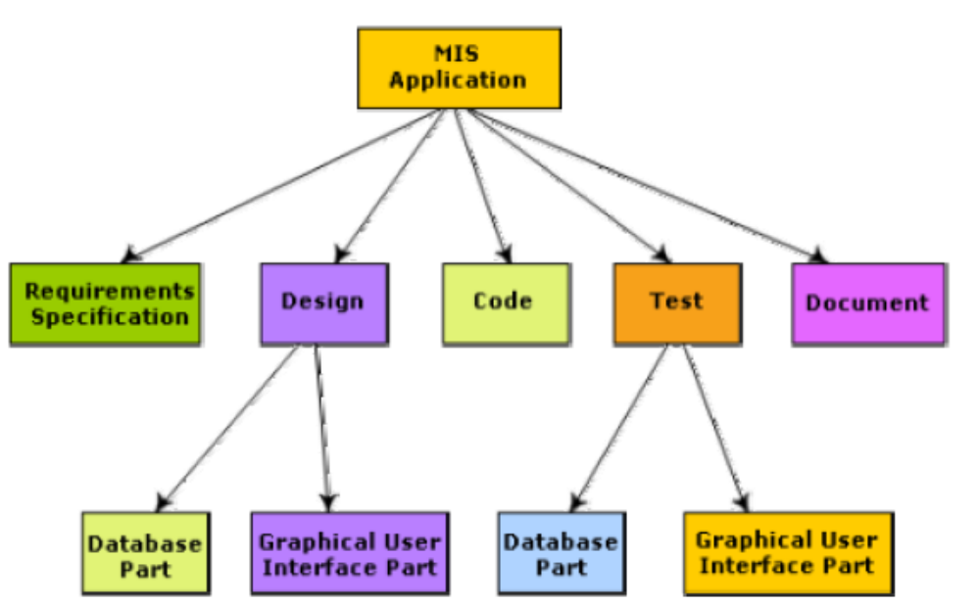
Work breakdown structure

Slide 63
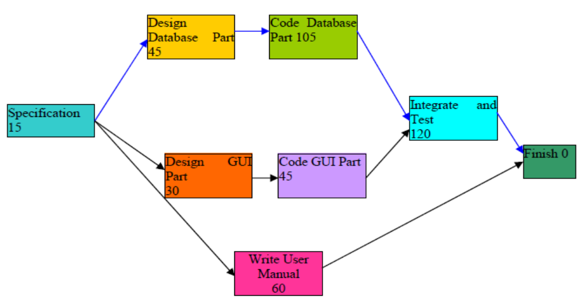
Activity network representation

Slide 64
Critical Path Method (CPM)
The minimum time (MT) to complete the project is the maximum of all paths from start to finish.
The earliest start (ES) time of a task is the maximum of all paths from the start to the task.
The latest start time is the difference between MT and the maximum of all paths from this task to the finish.
The earliest finish time (EF) =ES + the duration of the task.
The latest finish (LF) time =(task to finish from MT)-(maximum of all paths).
The slack time (ST) = (LS – EF) or (LF – EF).

Slide 65
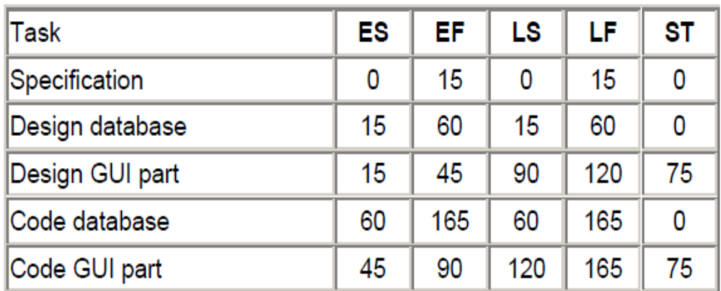
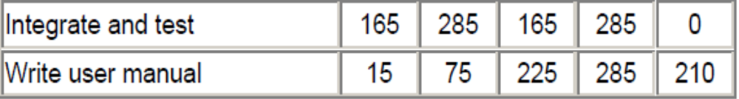
Project parameters computed from Activity Network

Slide 66
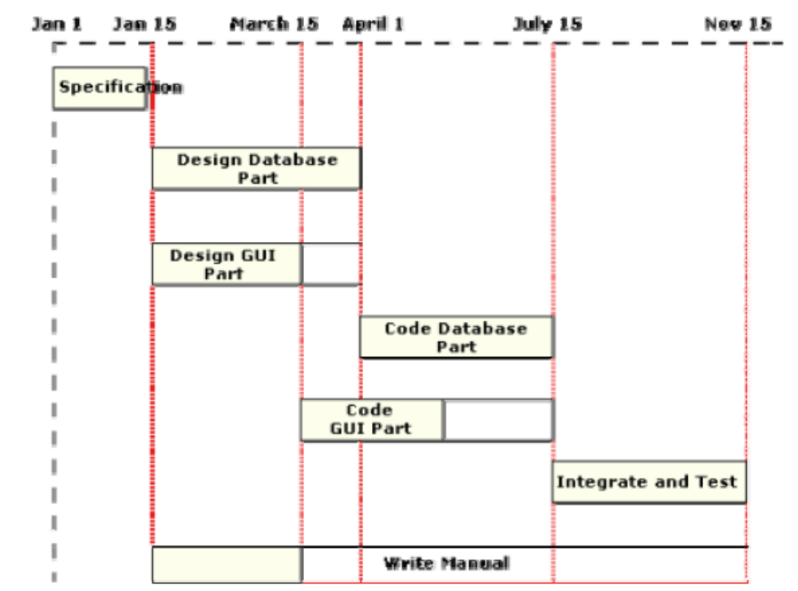
Gantt Chart

Slide 67
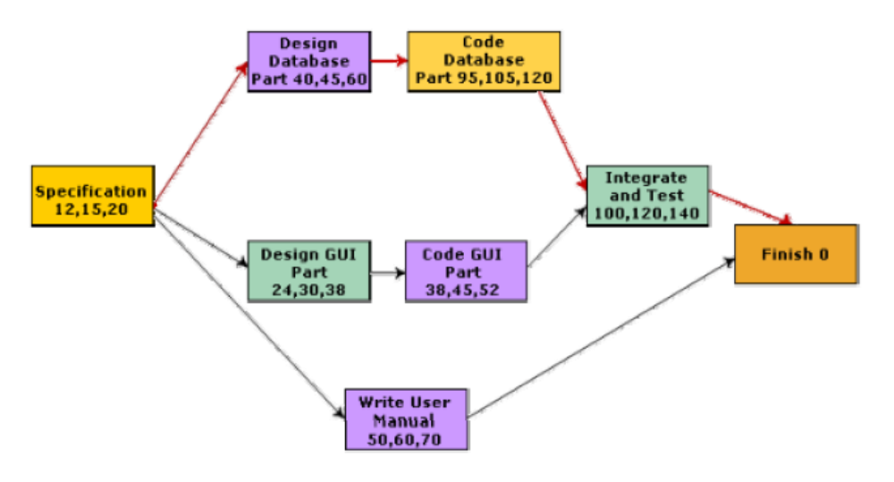
PERT Chart

Slide 68
Organization Structure
Functional Organization:
  Engineers are organized into functional groups, e.g.
    specification, design, coding, testing, maintenance, etc.
  Engineers from functional groups get assigned to different projects

Slide 69
Advantages of Functional Organization
Specialization
Ease of staffing
Good documentation is produced
  different phases are carried out by different teams of engineers.
Helps identify errors earlier.

Slide 70
Project Organization
Engineers get assigned to a project for the entire duration of the project
  Same set of engineers carry out all the phases
Advantages:
  Engineers save time on learning details of every project.
  Leads to job rotation

Slide 71
Team Structure
Problems of different complexities and sizes require different team structures:
  Chief-programmer team
  Democratic team
  Mixed organization

Slide 72
Team Organization
Software Engineer
Project Manager
Software Engineer
Democratic Team
Chief Programmer team

Slide 73
Mixed team organization
Project Manager
Senior Engineer
Software Engineer

